Slide 1

Design & simulation of an intelligent agent with RL
Alireza talakoobi 95242088
2020.9.01

Slide 2

Agenda
introduction
summary of NN & RL & DQN
Designing process
Results

Slide 3

Introduction
Let’s Dive In

Slide 4
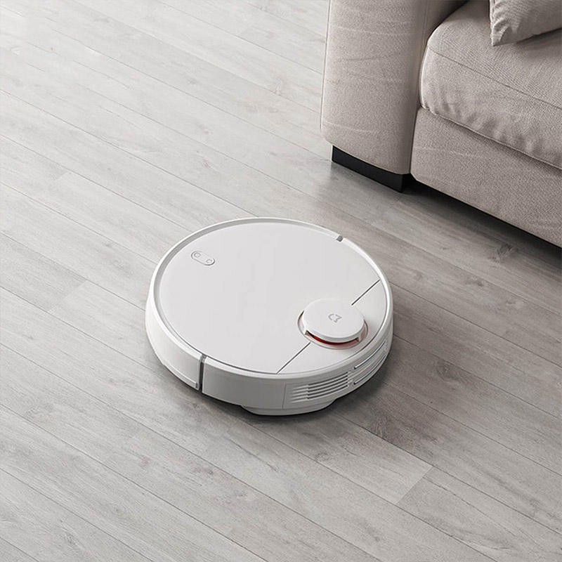
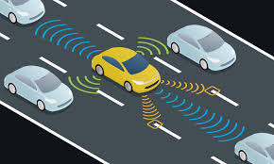
What is the goal?
Why reinforcement learning?
What we will achieve
The benefits of using this algorithm
An intelligent agent that can move around any environment with purpose
The agent can be used in real life machines such as:
Self driving cars
Robotic vacuum cleaners
…
Can easily get accustomed to new environments
RL can help with designing human like behaviors that are hard for us to program
Can be used when input and out put parameters are vast
Sensors are not precise but it is not a problem for RL
Can find solutions that are not logical to our minds but give better results
…

Slide 5
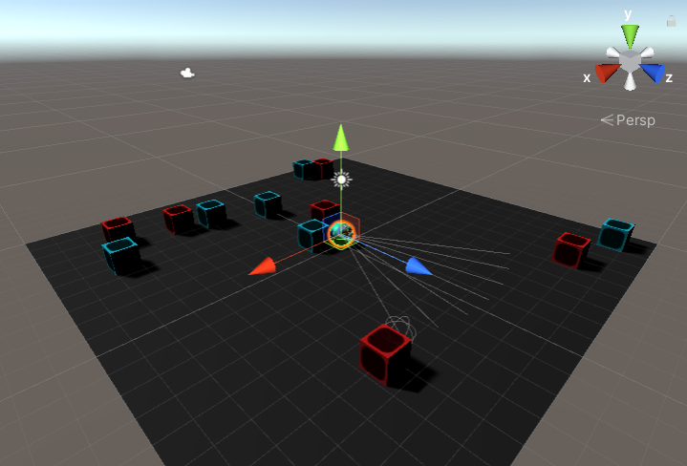
Project summary
environment
Simulation parts:
A flat square shaped plain that agent can fall from and get -10 point
An agent that can do 4 actions:
Move right
Move left
Rotate one degree, clockwise
Rotate one degree, counter clockwise
6 red cubes with random positions and -5 points at all times
6 blue cubes with random positions and +5 points at all times
What makes it so special?
The environment is completely different in each episode and that makes the agent able to act efficient in every environment.
Each episode can be represented to a different room with blue squares being trash and red squares being valuable furniture and the agent being a robotic vacuum cleaner

Slide 6
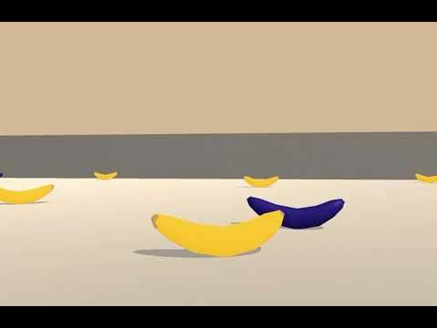
What are other people results
Page 1
This was originally a problem that was mentioned in a Udacity course for reinforcement learning. In that course the instructor asked students to share their results in GitHub so that every one could have a bench mark for themselves. But the original problem had many differences with what I have made
In the original problem the time limit was 1000 time steps that took about 20 seconds but in our problem the agent has 500 decision steps that takes about 10 seconds and this makes it harder for our agent.
Our agents sensor gets 34 parameters but the original agent has 37 parameters.
In the original problem there is a wall around the main ground that the agent can see and even can hit without making any problem but in our environment there isn't any wall around the environment to be seen by the sensor and if he agent exits this environment the episode will be lost and the agent will get -10 points.

Slide 7
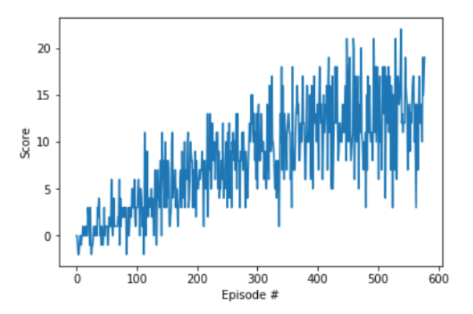
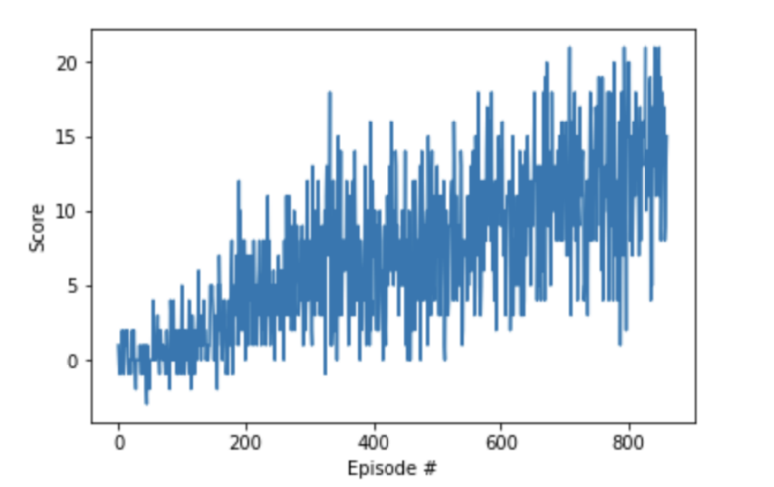
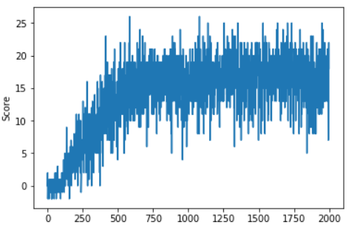
What are other people results
Page 2
First strategy:
second strategy:
third strategy:
( 13 × 5 ) / 2 - 7.5 = 25
( 13 × 5 ) / 2 - 7.5 = 25
( 13 × 5 ) / 2 - 7.5 = 35

Slide 8
INTRODUCTION to NN & RL & DQN
Let’s Dive In

Slide 9
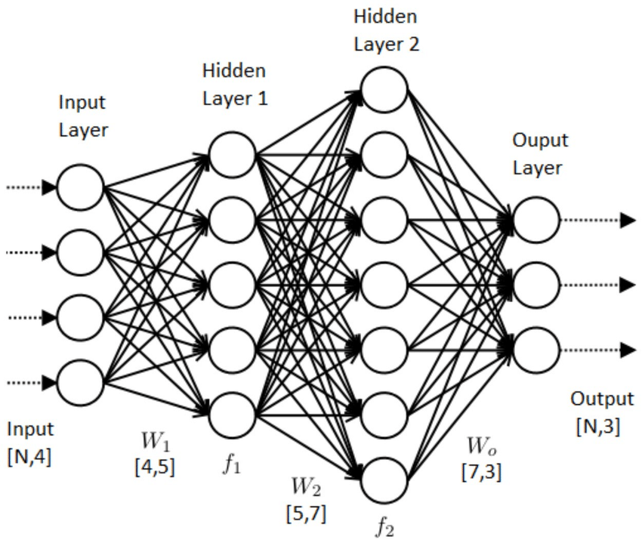
Neural networks
Quick introduction
A neural network is a series of algorithms that endeavors to recognize underlying relationships in a set of data through a process that mimics the way the human brain operates. In this sense, neural networks refer to systems of neurons, either organic or artificial in nature
It has different layers and by going from each layer to the next one a new set of computations will happen to our input so that by the time it has reached our final layer it will produce the desired answer to our problem in hand.

Slide 10
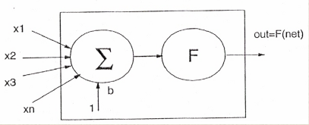
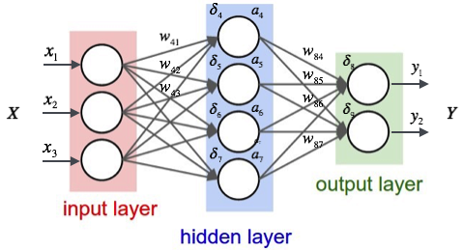
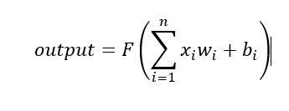
How it works
pictures

Slide 11



Reinforcment learning
Quick introduction
Reinforcement learning is the training of machine learning models to make a sequence of decisions. The agent learns to achieve a goal in an uncertain, potentially complex environment. In reinforcement learning, an artificial intelligence faces a game-like situation. The computer employs trial and error to come up with a solution to the problem. To get the machine to do what the programmer wants, the artificial intelligence gets either rewards or penalties for the actions it performs. Its goal is to maximize the total reward.
Although the designer sets the reward policy–that is, the rules of the game–he gives the model no hints or suggestions for how to solve the game. It’s up to the model to figure out how to perform the task to maximize the reward, starting from totally random trials and finishing with sophisticated tactics and superhuman skills

Slide 12
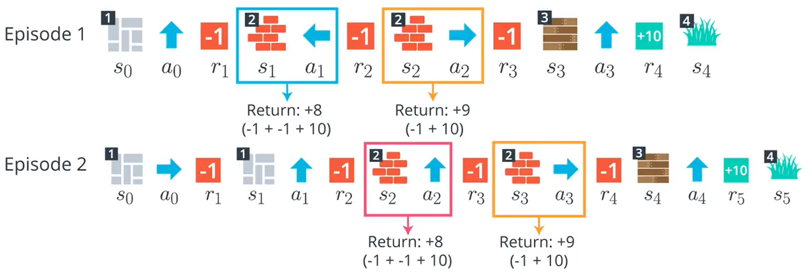
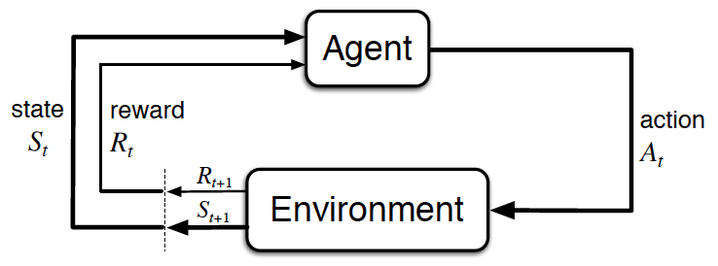
What is an episode
S,A,R,S,A,R,…
EPISODE :
S0 , A0 , R1 , S1 , A1 , R2 , … , ST

Slide 13
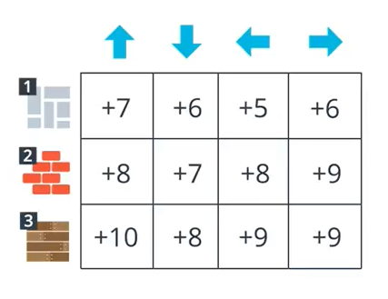
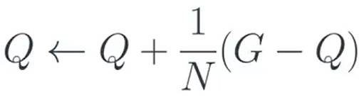
Q-table
State-action

Slide 14
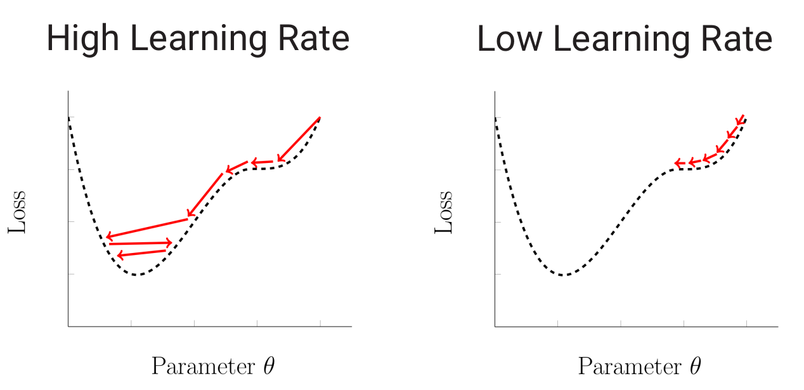
Explore exploit dilemma
Which one to choose?
1. Always Exploiting
You wouldn’t know if you could earn more by pulling other levers.
2. Always Exploring
You wouldn’t learn anything from your previous actions.
3. Epsilon Greedy
You pull the best lever 70% of the time (exploitation). And 30% of the time at random (exploration)

Slide 15
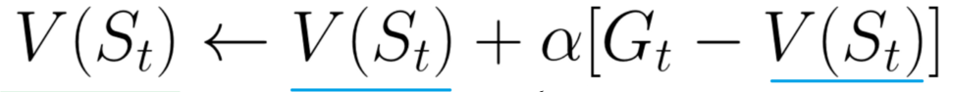
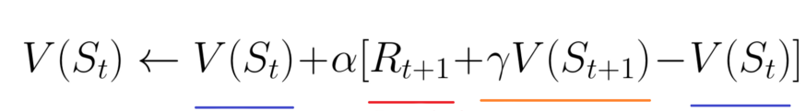
Different methods
Which one to choose?
Monte carlo
Td learning
Sarsa(0)
Sarsa max = Q-learning
Expexted sarsa
Ppo
Deep Q-networks

Slide 16
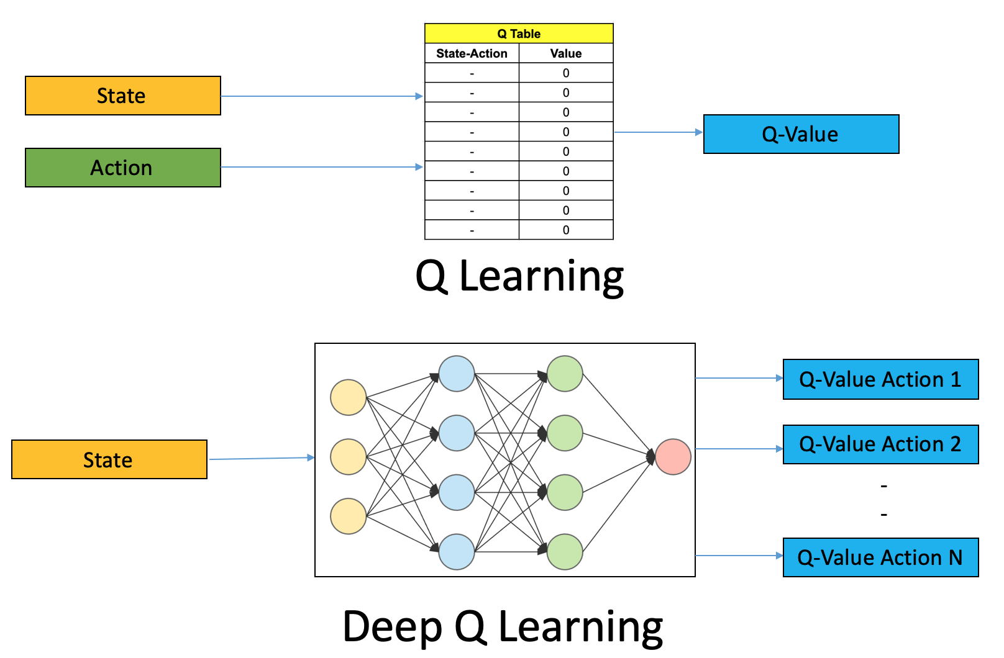
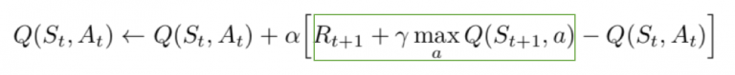
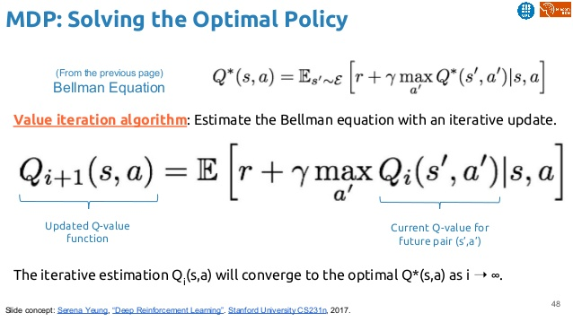
Deep q-networks
Page 2

Slide 17
Designing process
Let’s Dive In

Slide 18
summary
Simulation (unity, c#)
NN code (python)
DQN code (python)
Main code (python)

Slide 19

simulation
LOOKING AHEAD

Slide 20
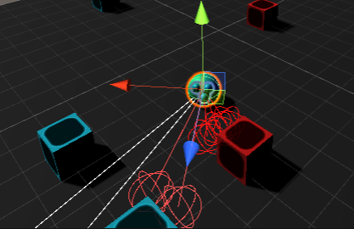
simulation
Page 1

Slide 21
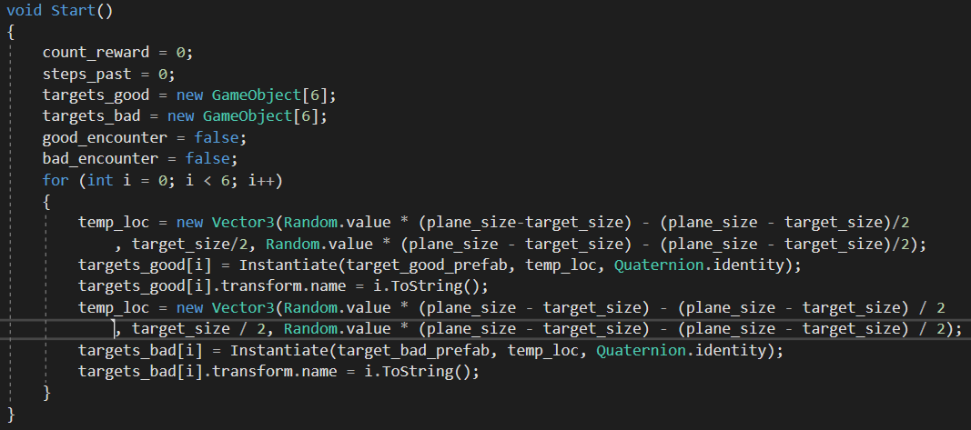
simulation
start

Slide 22
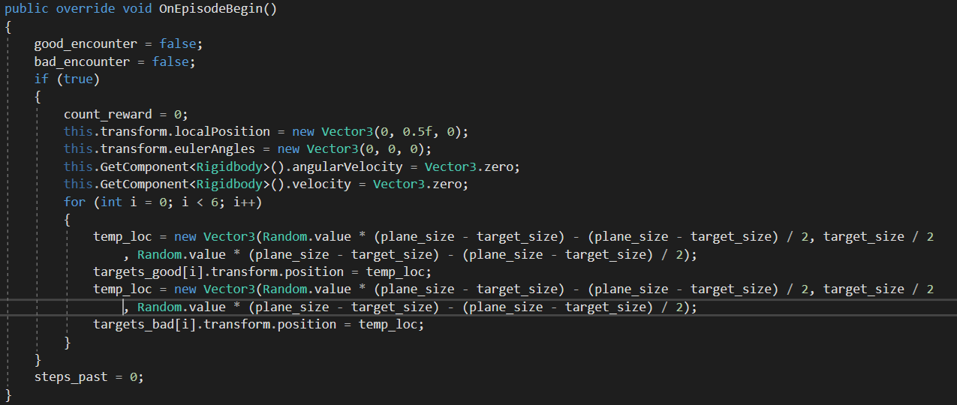
simulation
On episode begin

Slide 23
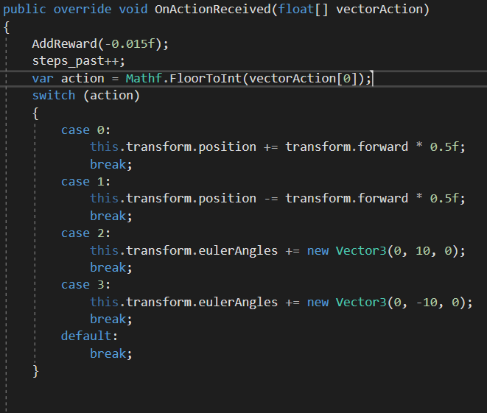
simulation
Action chooser

Slide 24
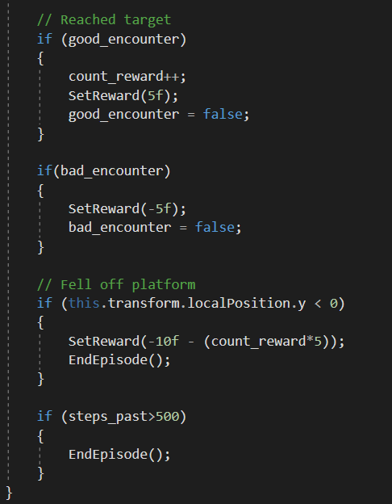
simulation
rewards

Slide 25
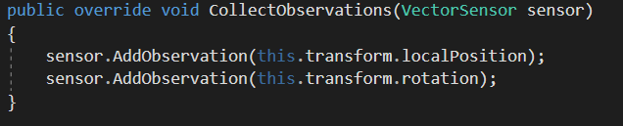
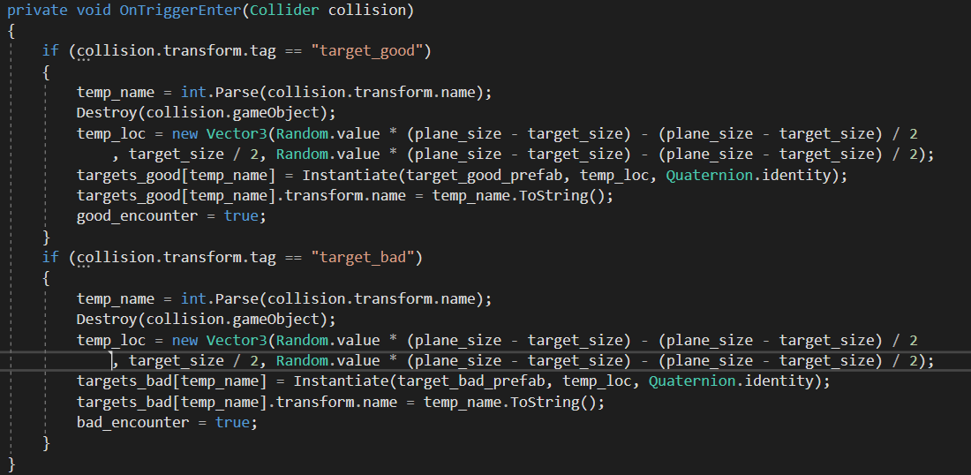
simulation
State, collision

Slide 26
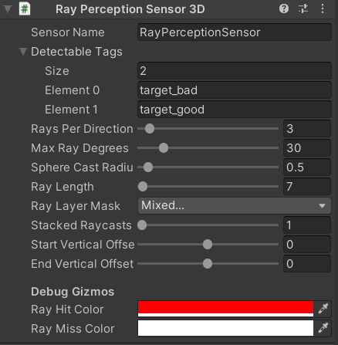
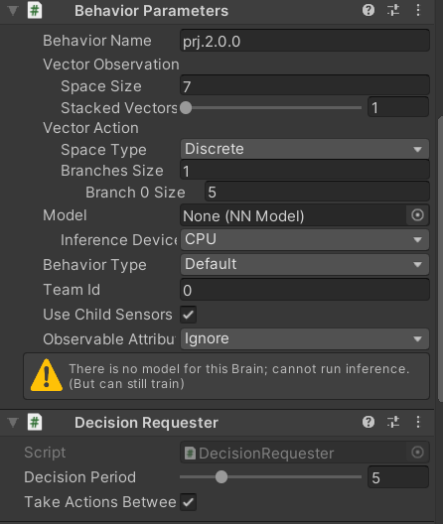
simulation
Choosing settings

Slide 27
NN code
LOOKING AHEAD

Slide 28
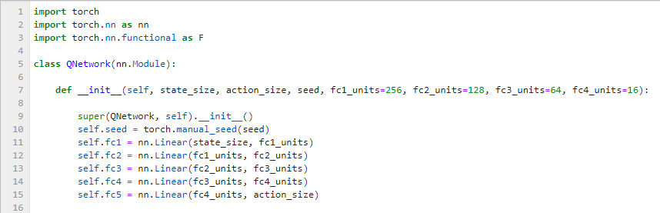
Neural network code
intializing

Slide 29
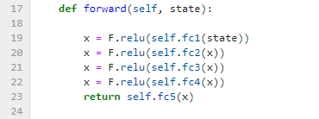
Neural network code
Forward propagation

Slide 30
DQN code
LOOKING AHEAD

Slide 31
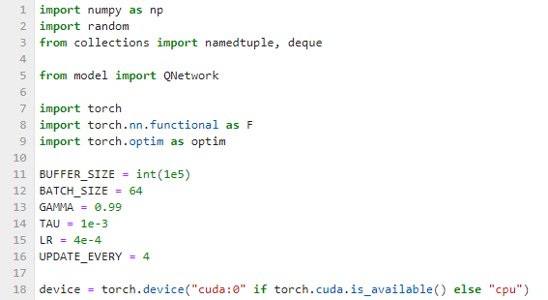
Deep Q-network code
start

Slide 32
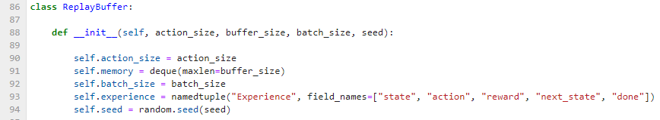
Deep Q-network code
Memory initialize

Slide 33
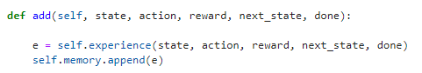
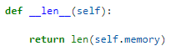
Deep Q-network code
Add&lenght

Slide 34
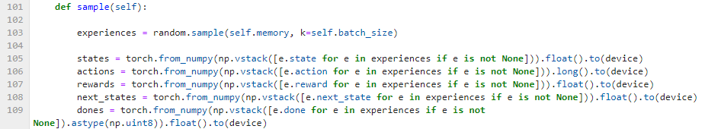
Deep Q-network code
Random sample

Slide 35
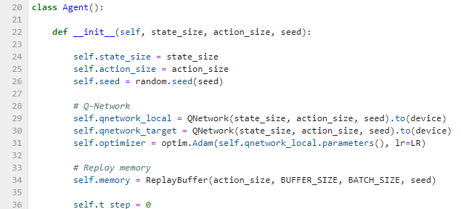
Deep Q-network code
Agent initialize

Slide 36
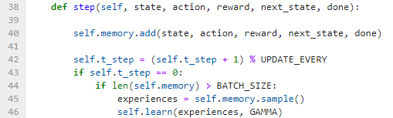
Deep Q-network code
Step(save experience)

Slide 37
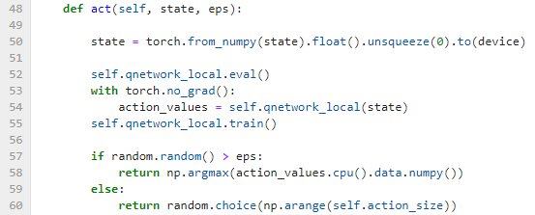
Deep Q-network code
Act(choose action)

Slide 38
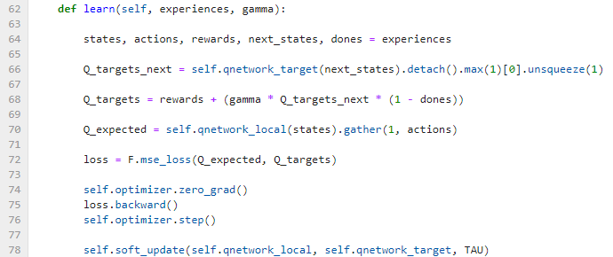
Deep Q-network code
learning

Slide 39
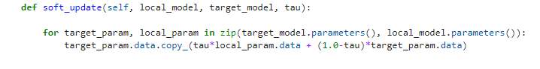
Deep Q-network code
updating

Slide 40
Main code
LOOKING AHEAD

Slide 41
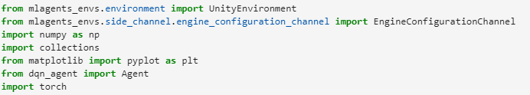
main code
start

Slide 42
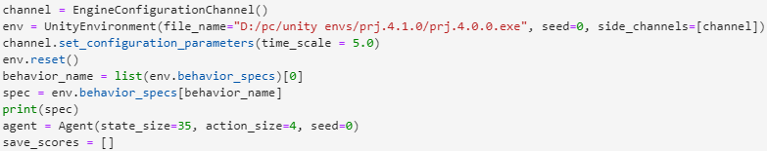
main code
Page 3

Slide 43
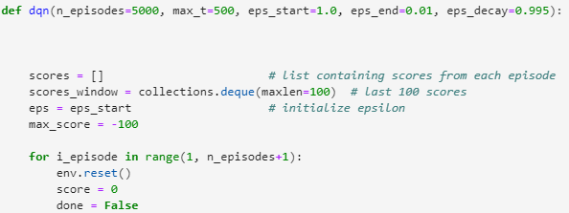
main code
Main part start

Slide 44
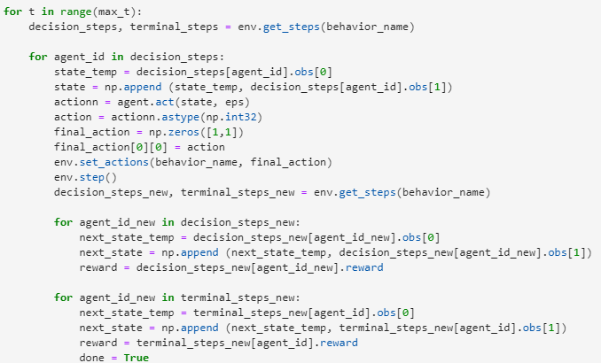
main code
Main part main

Slide 45
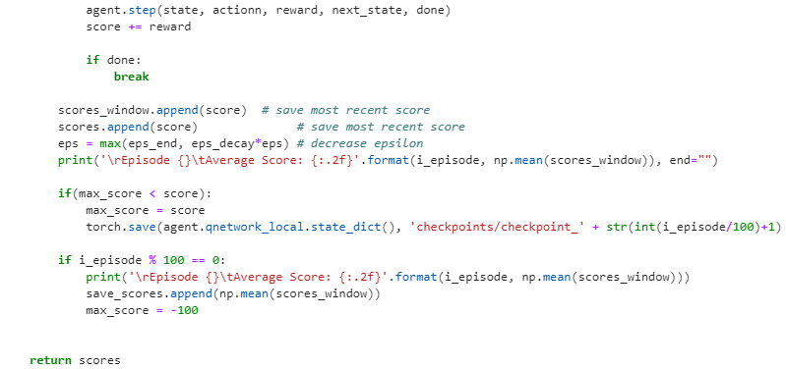
main code
Main part saving

Slide 46
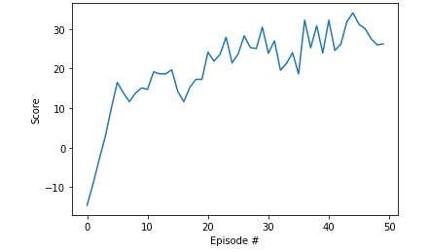
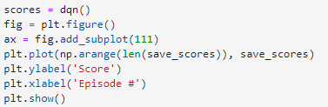
main code
Show results

Slide 47
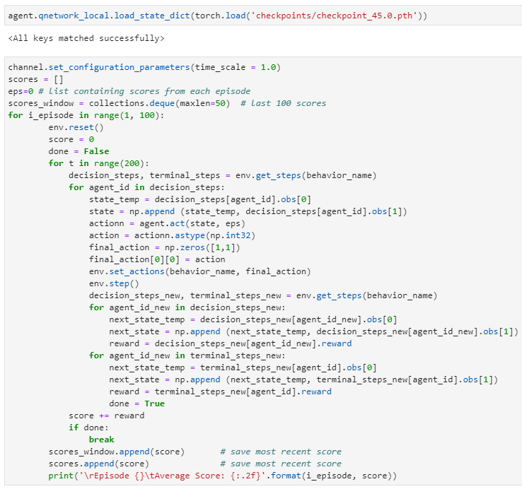
main code
Load network

Slide 48
main code
Load network

Slide 49
Results
Let’s Dive In

Slide 50
Main parameters
What do they do?
Learing rate = 4 × 10⁻⁴
Batch size = 64
Buffer size = 10⁵
Hidden units = 256, 128, 64, 16
Number of layers = 4
6. Epsilon = (start = 1, end = 0.01, decay = 0.995)
7. Tau = 0.001
Update every = 4
Gamma = 0.99

Slide 51


Results
4.1.1
4400 - 4500
47.25 → 10.5

Slide 52

Results
4.1.1

Slide 53


Results
gamma:
^{0.50}
4.1.7
^{0.99}
3600 - 3700
20.32 → 5.5
700 – 800 → 4.81

Slide 54

Results
4.1.7

Slide 55


Results
Learning rate:
4 × 10⁻³
4 × 10⁻⁴
4.1.4
1100 - 1200
25.20 → 6.5
500 – 600 → 24.15

Slide 56

Results
4.1.4

Slide 57


Results
epsilon:
^{1, 0.005,0.999}
4.1.8
^{1, 0.01,0.995}
4800 - 4900
35.83 → 8.5
1300 – 1400 → 15.81

Slide 58

Results
4.1.8

Slide 59


Results
Number of layers:
3 : 128,64,16
4 : 256,128,64,16
4.1.2
4100 - 4200
37.05 → 9

Slide 60

Results
4.1.2

Slide 61


Results
Hidden units:
3 : 128,64,16, 8
4 : 256,128,64,16
4.1.3
4300 - 4400
42.02 → 10
800 – 900 → 17.31

Slide 62

Results
4.1.3

Slide 63


Results
Update every:
²
4.1.5
⁴
4300 - 4400
44.15 → 10.5
800 – 900 → 28.09

Slide 64

Results
4.1.5

Slide 65


Results
gamma:
^{0.90}
4.1.6
^{0.99}
4200 - 4300
50.12 → 11.5
400 – 500 → 17.09

Slide 66

Results
4.1.6

Slide 67
What are other people results
Page 2
first strategy:
second strategy:
third strategy:
( 13 × 5 ) / 2 - 7.5 = 25
( 13 × 5 ) / 2 - 7.5 = 25
( 13 × 5 ) / 2 - 7.5 = 35

Slide 68
THANK YOU very much for your time

